Slide 1
Lines that
touch me

Slide 2
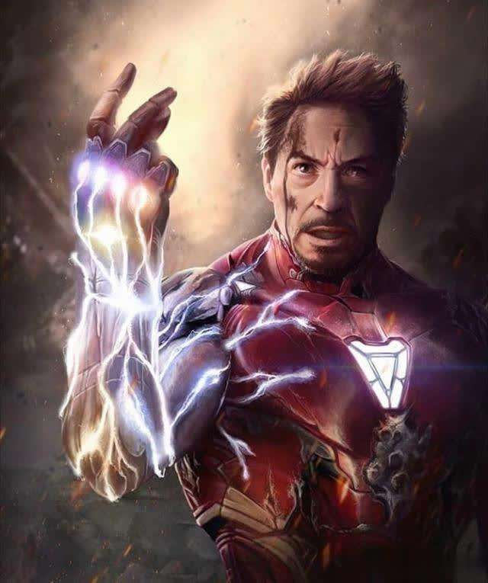
1
<Iron Man>
I’m iron man.
——Tony Stark

Slide 3
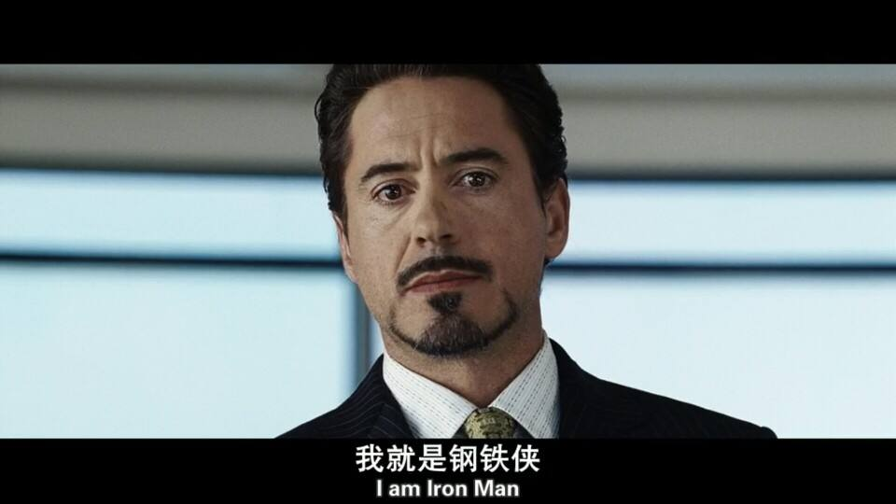

Slide 4
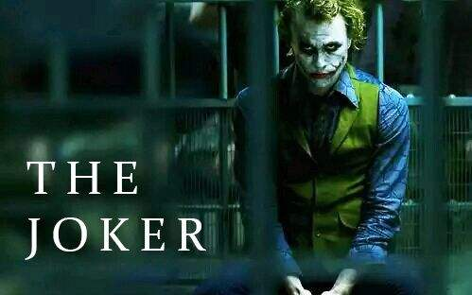
2
<The Dark Knight Rises>
Why so serious?
——Joker

Slide 5
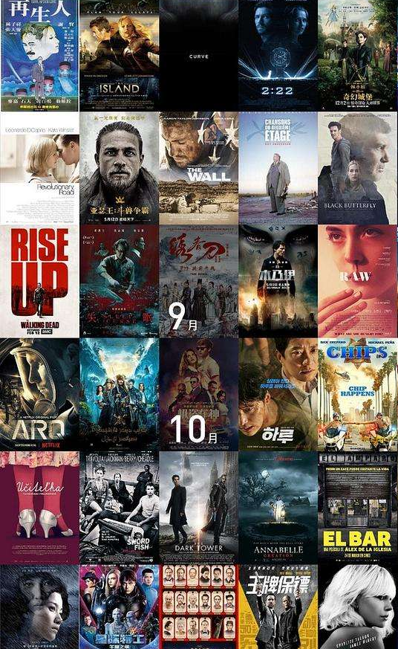

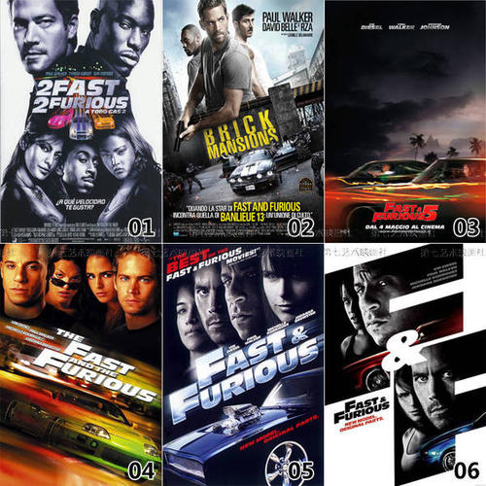

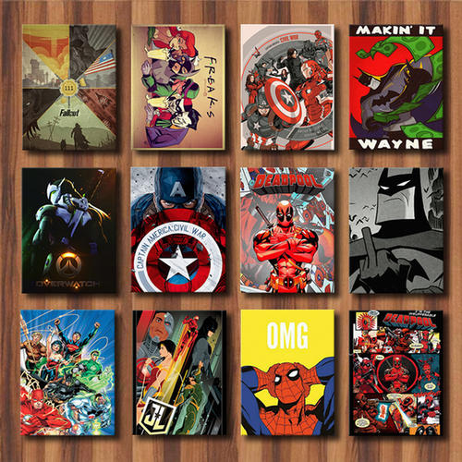
3

Slide 6

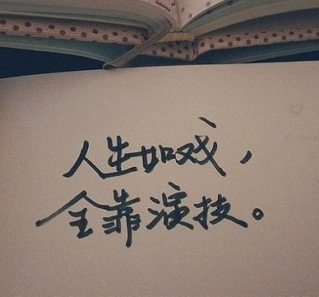


01
Part One
问题场景
Connection
Performance
Script

Slide 7
Script
01
The basic factor

Slide 8
unforgettable

Slide 9
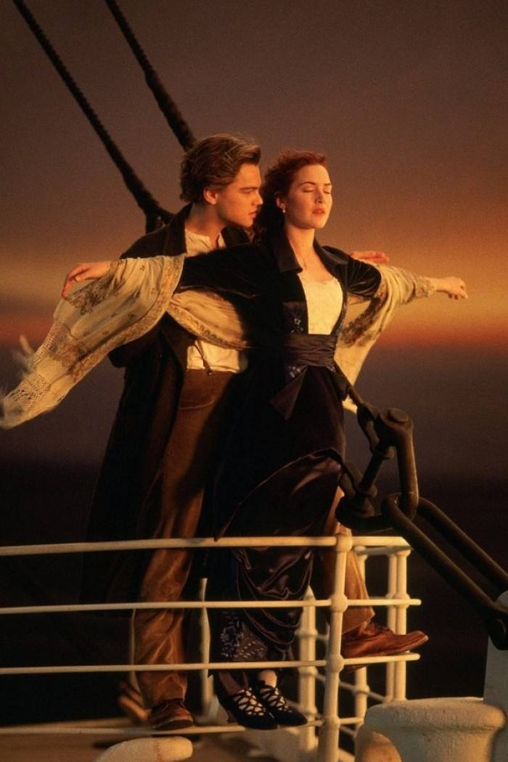
4
<Titanic>
You jump, I jump.
——Leonardo DiCaprio

Slide 10
Performance
02
The most direct factor

Slide 11
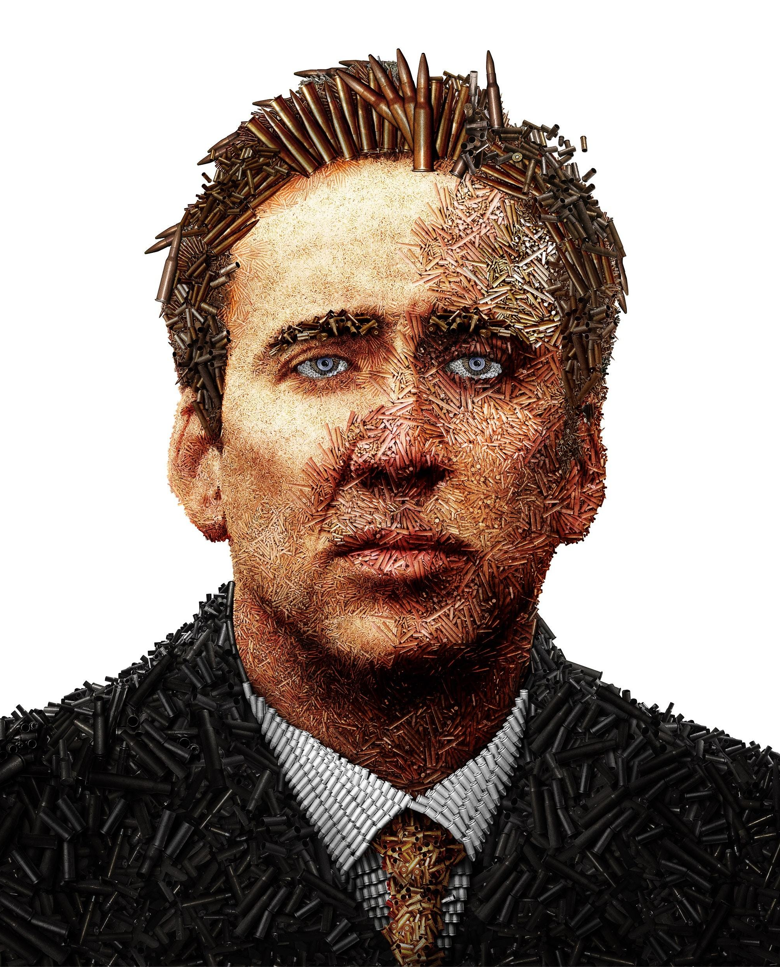
5
<Lord of War>
there are over 550 million firearms in worldwide circulation. That’s one firearms for every 12 people on the planet. The only question is how do we arm the other 11?.
——Nicolas Cage

Slide 12
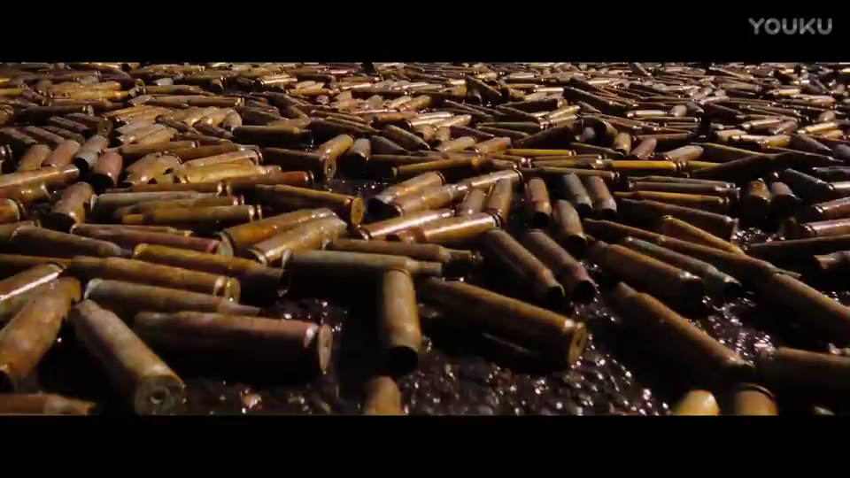
5
<Lord of War>

Slide 13
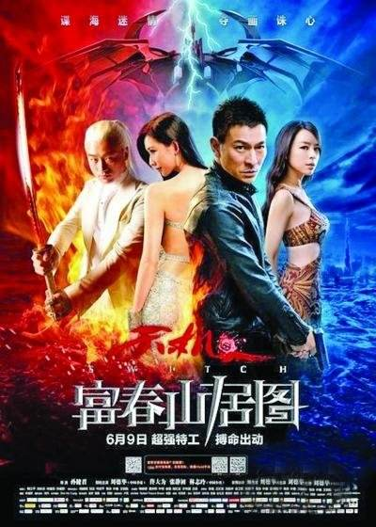
6
<Switch>

Slide 14


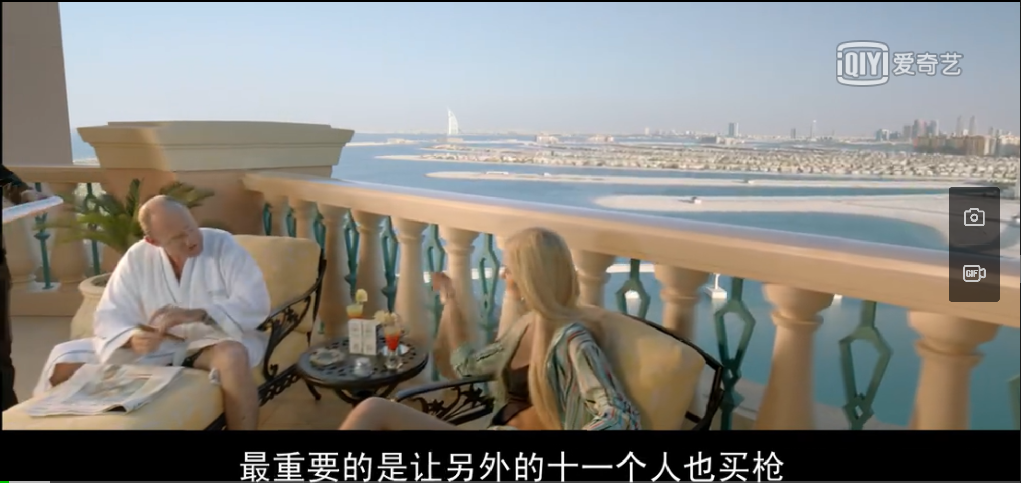

Slide 15
connection
03
The most important factor

Slide 16

6
<Let the bullet fly>

Slide 17
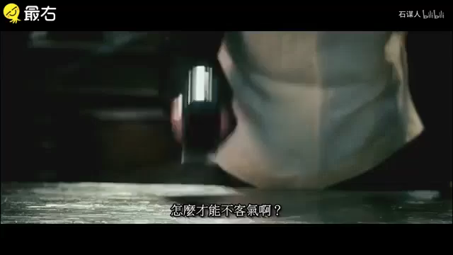

Slide 18
The money matters,
the dignity is also
important.

Slide 19
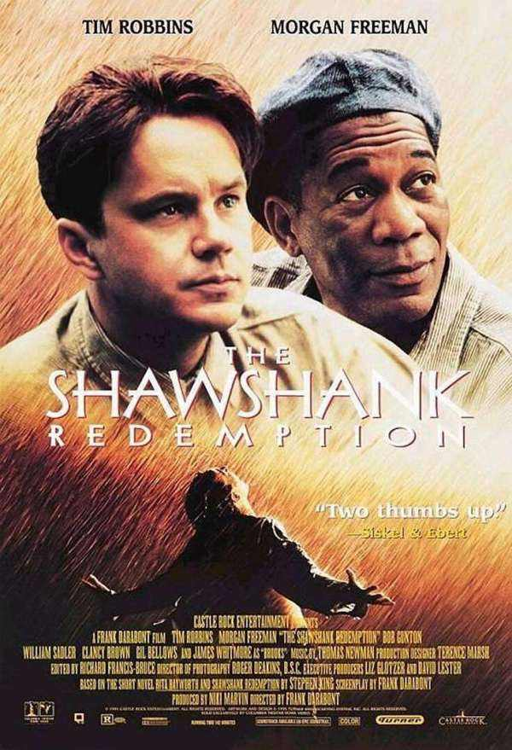
7
<Shawshank Redemption>
Hope is a good thing,
maybe the best of thing.
And no good thing ever dies.
——Andy Dufresne

Slide 20
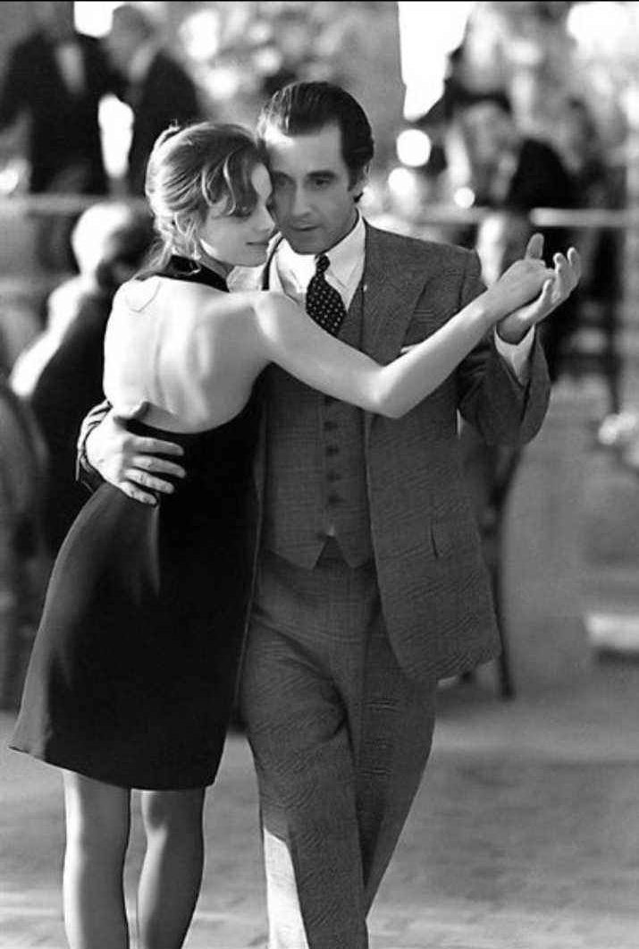
8
<the Scent of Women>
If you
made a mistake,
get all tangled up,
just tango on.
——Colonel

Slide 21
magic of lines.
magic of movies.
Enjoy the movies

Slide 22
THANK YOU
FOR WATCHING
电气810-聂永欣

